Slide 1
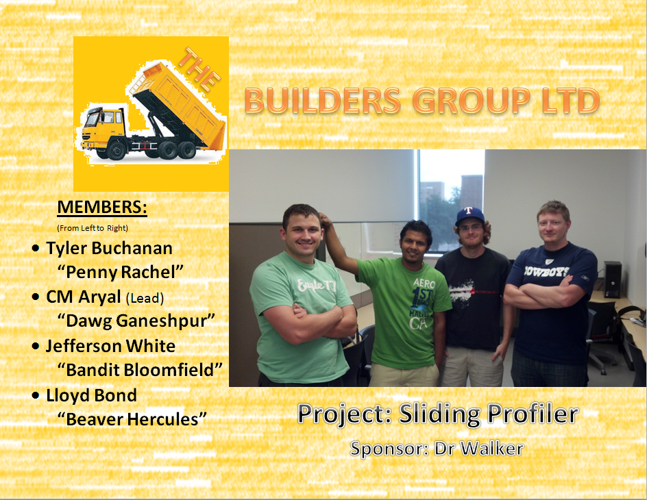

Slide 2
SRD UPDATES
Removed car battery
Refined cost analysis
Refined performance requirements
Upgraded UI diagrams
Packaging Requirements
Added electronic housing
Added software support

Slide 3
Other
Continued to meet with sponsor
Received documentation regarding bump detection algorithm
Monitored existing risks

Slide 4
Work Outlook
Refine MS Project plan
Refine Project Charter
Start Architecture

Slide 5
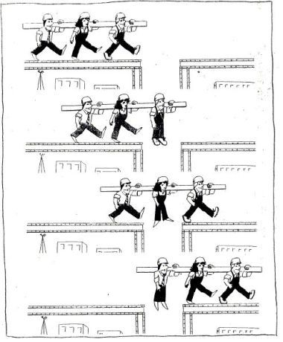
Failed Team Name Ideas
Dark Matter Love <3
Because everyone likes a bit
of the dark matter
Team BAWB
WABB_{LE} CREW
Sexual Chocolate
Steele Productions
Team Daedylus
Perpetual Motion Squad
(all night long)
PMS for short
Dawg Squad

